Slide 1

Note: The data and information in this document is reflective of a hypothetical situation and client. This document is to be used for KPMG Virtual Internship purposes only.
Sprocket Central Pty Ltd
Data analytics approach

Slide 2
Note: The data and information in this document is reflective of a hypothetical situation and client. This document is to be used for KPMG Virtual Internship purposes only.
Agenda
Introduction
Data Exploration- Relationship between data and features
Model Development- data transformation & modelling
Interpretation- reporting of key findings

Slide 3
Note: The data and information in this document is reflective of a hypothetical situation and client. This document is to be used for KPMG Virtual Internship purposes only.
Introduction
NEW CUSTOMER ANALYSES
These are the 5 features that we use for recommendations of new customers
Age Distributions
Number of purchases in past 3 years
Job Industry Category
Wealth Segments
No of car owned in each states

Slide 4
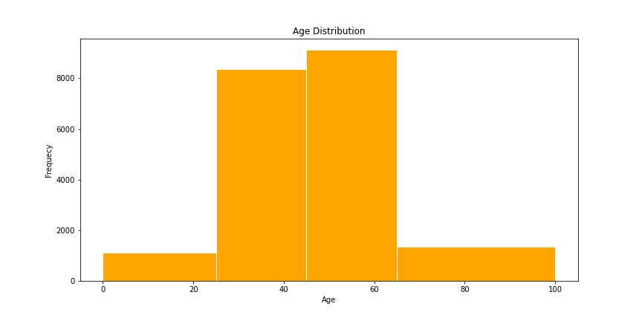
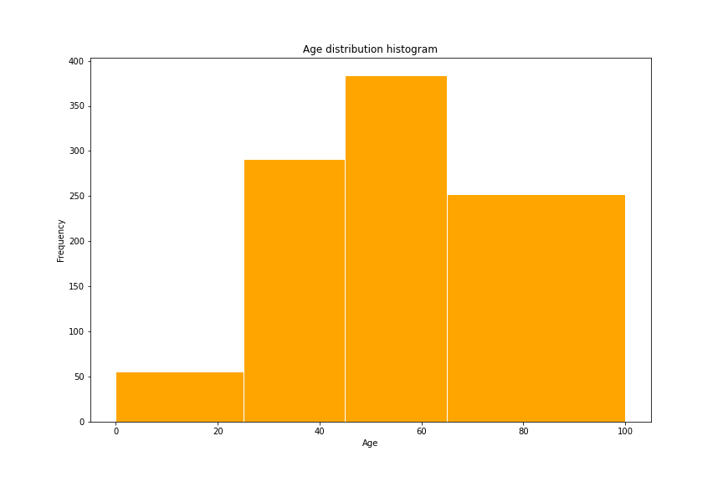
Note: The data and information in this document is reflective of a hypothetical situation and client. This document is to be used for KPMG Virtual Internship purposes only.
DATA - EXPLORATION
Customer’s Age Distribution
The percentage of customers of age group <25 years is similar to the existing customer groups
There are slight percentage of customers in the age group 25-44 years
Most new customers are in the age group 45-65 years old.
There are much more customers in the age group >=65 years as compared to the original customers group.

Slide 5
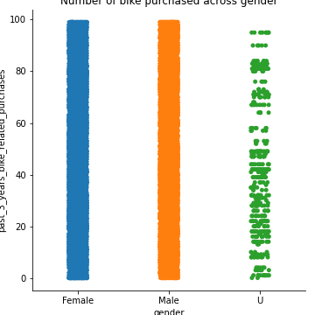
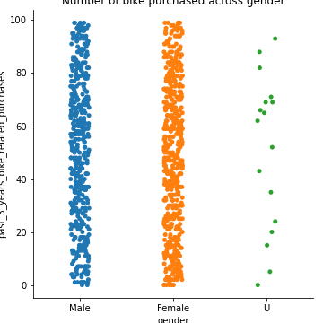
Note: The data and information in this document is reflective of a hypothetical situation and client. This document is to be used for KPMG Virtual Internship purposes only.
Model Development
Bike purchases within the last 3 years
In the new customers group no of females buyers (25,212 ie 50.6%) are more than the male buyers (23,765 ie 47.7%)
The distribution is very similar in the two groups. So we can focus more on male buyers or we can focus on female buyers retention.

Slide 6
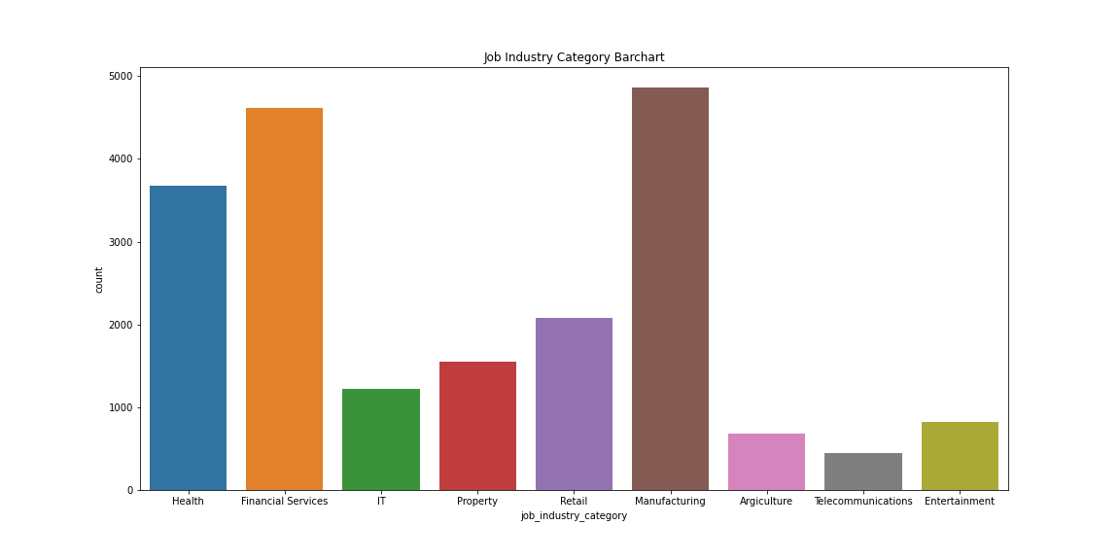
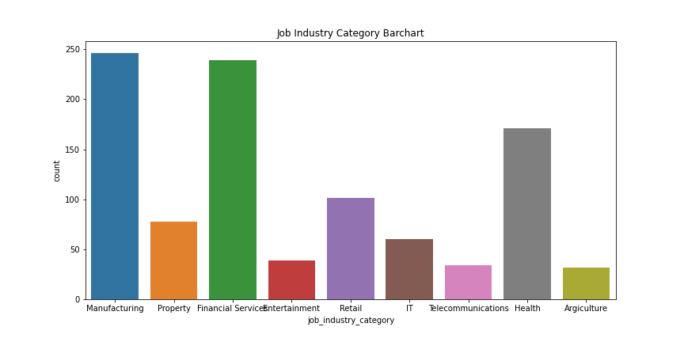
Note: The data and information in this document is reflective of a hypothetical situation and client. This document is to be used for KPMG Virtual Internship purposes only.
Interpretation
Job Industry Category
The industry category of new customers group is similar to the old customer group.
Top three industry profiles for old customers base: Manufacturing, Financial Services and Health respectively.
Top three industry profiles for new customers base: Manufacturing, Financial Services and Health respectively.

Slide 7
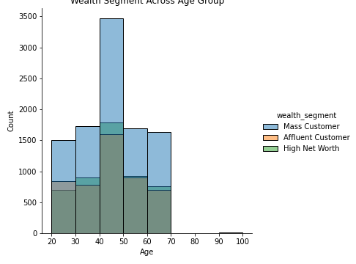
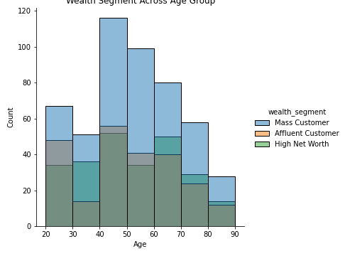
Note: The data and information in this document is reflective of a hypothetical situation and client. This document is to be used for KPMG Virtual Internship purposes only.
Interpretation
Wealth Segments
The average age of new customers group is more compared to the old customer group.
Across all age groups the mass customer base is the biggest.
There are relatively lower proportions of Mass customer base as compared to Affluent and High Net Worth groups in the new customer group.
We can focus more on above two groups.

Slide 8
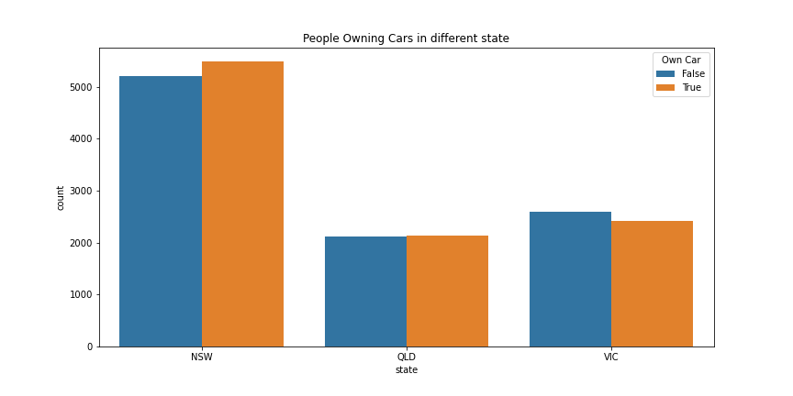
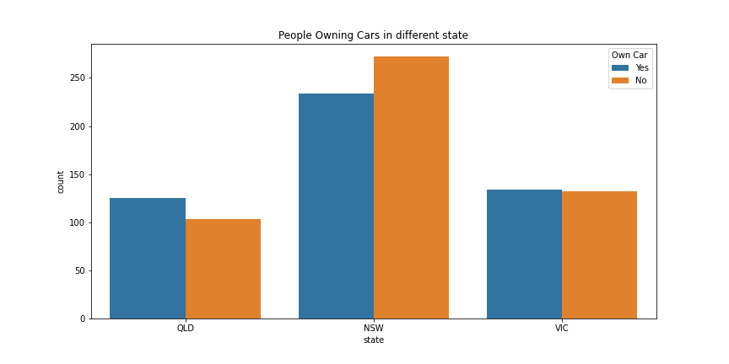
Note: The data and information in this document is reflective of a hypothetical situation and client. This document is to be used for KPMG Virtual Internship purposes only.
Interpretation
No of cars owned in each state
NSW has more number of owned cars but proportionally has the more customers who doesn’t own cars.
VIC is the next highest in the number of owned cars, and there relatively equal proportion who doesn’t own cars.
QLD has the least number of owned cars, so we could target this state.

Slide 9
Note: The data and information in this document is reflective of a hypothetical situation and client. This document is to be used for KPMG Virtual Internship purposes only.
Thank You

